Slide 1
Handwritten Digit Recognition
(A convolutional Neural Network Approach)
Team member :
1.monu yadav
2.sonu kumar
3.purushottam singram

Slide 2
Introduction
What is Digit Recognition?
Digit recognition is the ability of a model to accurately identify handwritten or printed digits (0-9) from images.
Why is it Important?
Automation: Plays a key role in automating processes like form digitization, banking transactions, and postal sorting.
Accessibility: Facilitates OCR (Optical Character Recognition) for people with disabilities.
Data Input: Streamlines human-computer interaction in applications like mobile banking apps and touchscreen devices.

Slide 3
Benefits of Digit Recognition
How Does It Help?
Reduces manual effort in digitization tasks.
Minimizes human errors in recognizing digits.
Processes large datasets quickly.

Slide 4
How Are We Going to Do It?
Our Approach
Data Collection: Use a dataset like MNIST or Extended MNSIT (0-9, a-b )
Model Training: Develop and train a neural network to classify digits.
Evaluation: Test the model on unseen data to ensure reliability.
Deployment: Deploy the model into real-world applications.

Slide 5
Tools & Techniques
What Are We Using?
Frameworks:
TensorFlow, PyTorch, tesserct js etc.
Dataset:
MNIST.
Techniques:
Neural Networks (e.g., CNNs).
Data preprocessing (normalization, augmentation).
Conture detection
Visual:
Highlight tools and frameworks with logos/icons (e.g., Python, TensorFlow).

Slide 6
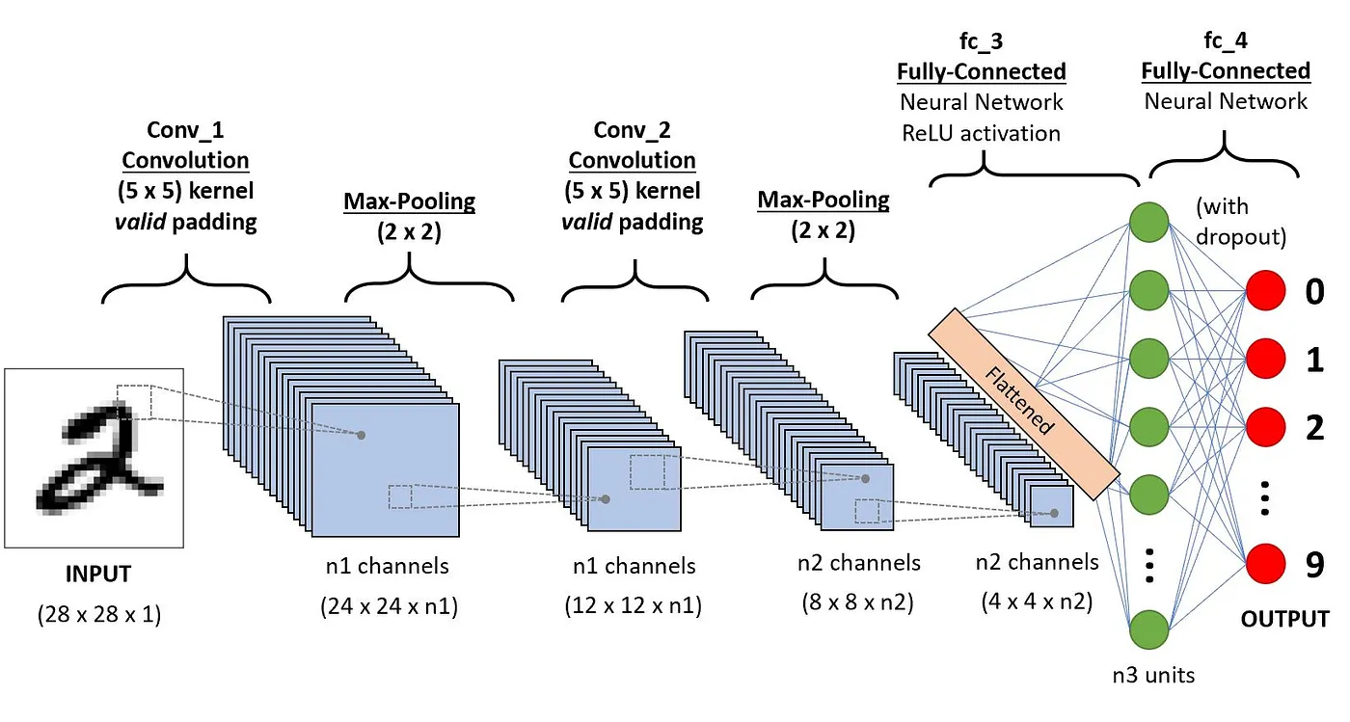
What is CNN (Convolutional Neural Network)?
A Convolutional Neural Network (CNN) is a type of deep learning model specifically designed to process and analyze grid-like data structures, such as images.

Slide 7
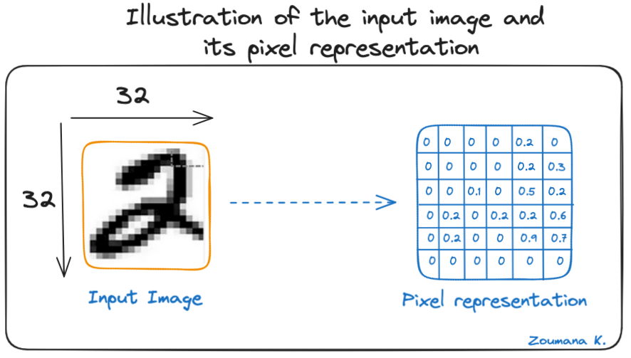
What is CNN (Convolutional Neural Network)?

Slide 8
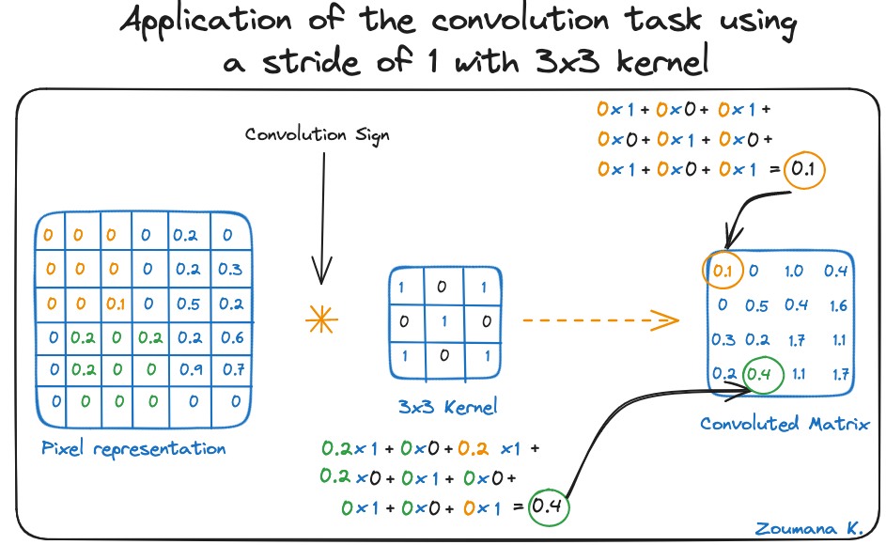
What is CNN (Convolutional Neural Network)?

Slide 9
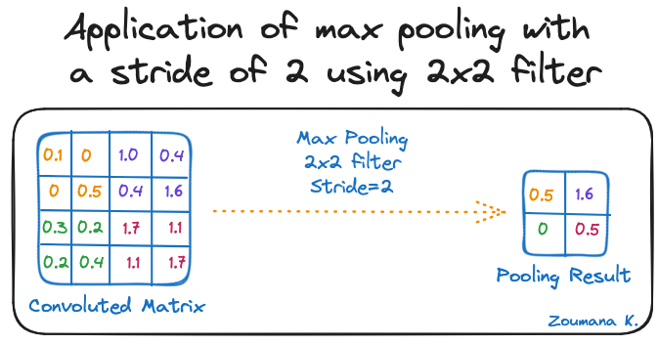
What is CNN (Convolutional Neural Network)?

Slide 10
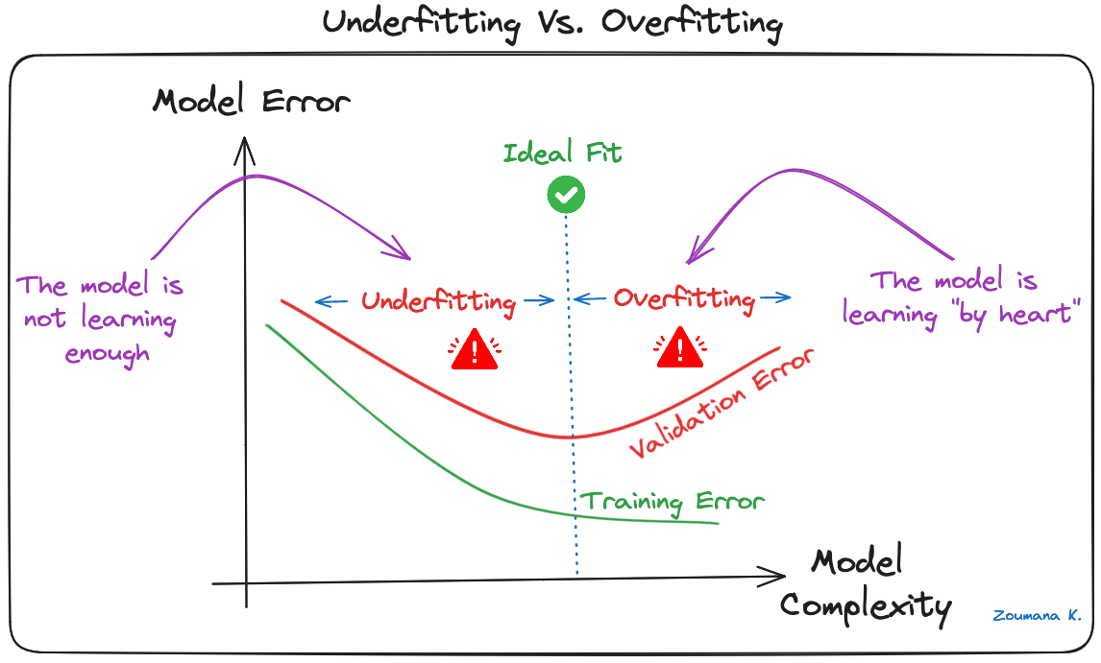
What is CNN (Convolutional Neural Network)?

Slide 11
Challenges & Solutions
Challenges with Chaotic Input:
Low accuracy when recognizing overlapping digits or noisy data.
Solution:
Contour Detection: Break input into sub images.
Apply CNN to sub-images and recombine results.

Slide 12

CNN (Convolutional Neural Network)
It can easily detect whole input
Detected : 5
Accuracy: 0.9

Slide 13
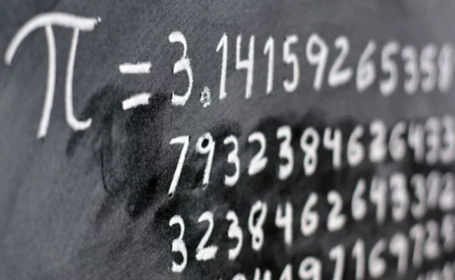
CNN (Convolutional Neural Network)
But It struggle with chaotic input
If we want to extract those digits or character from image input
Detected : 3
Accuracy: 0.1

Slide 14
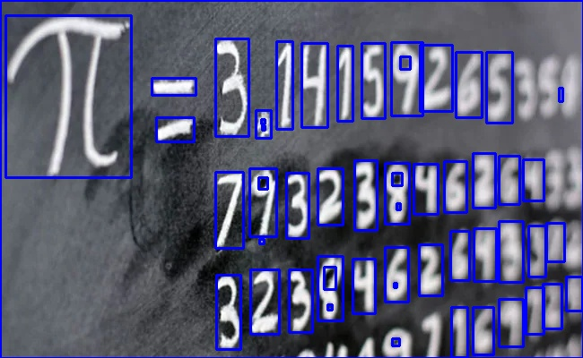
So how we going to solve it - Using Conture
We will break the input into sub input and on those sub inputs we would apply cnn method after that we would add those detected digit at one string and that would be our result

Slide 15
So how we going to solve it
We will break the input into sub input and on those sub inputs we would apply cnn method after that we would becom those detected digit at one string and that would be our result
Extracted text :
di = 3 1415924538
32304634000
Accuracy : 0.8

Slide 16


Image Preprocessing for Digit Recognition
28 X 28
101X101

Slide 17
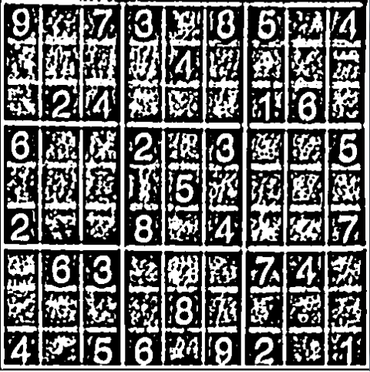
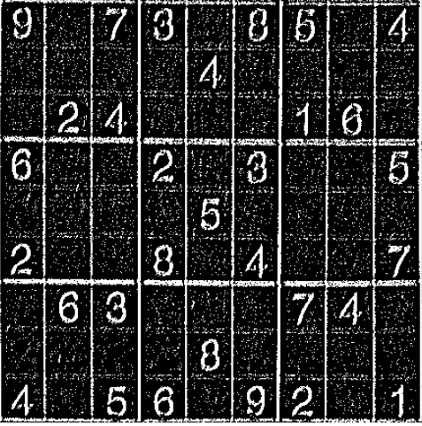
Image Preprocessing for Digit Recognition

Slide 18
Application
Where it can be used ? OverSpeed car number (nameplate) recognition Bank cheque digitization. Postal code recognition Document OCR for hospitals and government offices

Slide 19
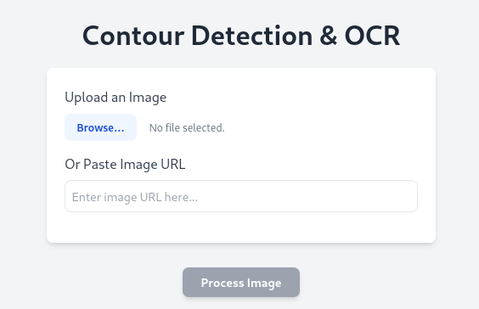
Application is live at :
https://ocr-pro.pages.dev/

Slide 20


Slide 21


